Slide 1
Dose Distributions and Defining Quantities
Shannon O’Reilly
August 8th, 2016

Slide 2
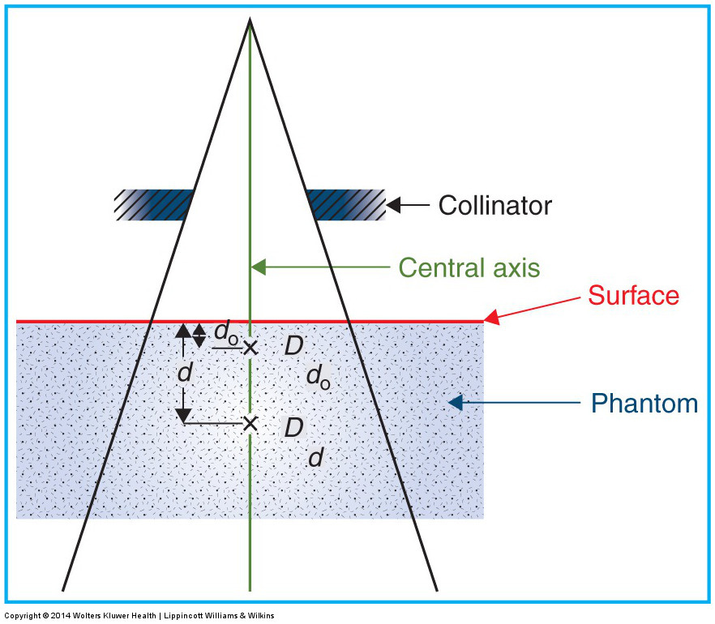

Percent Depth Dose
PDD = $\frac{D_{d}}{D_{max}}$ x 100
Dependent on:
Energy
Depth
SSD
Field size @ surface
Modifier

Slide 3
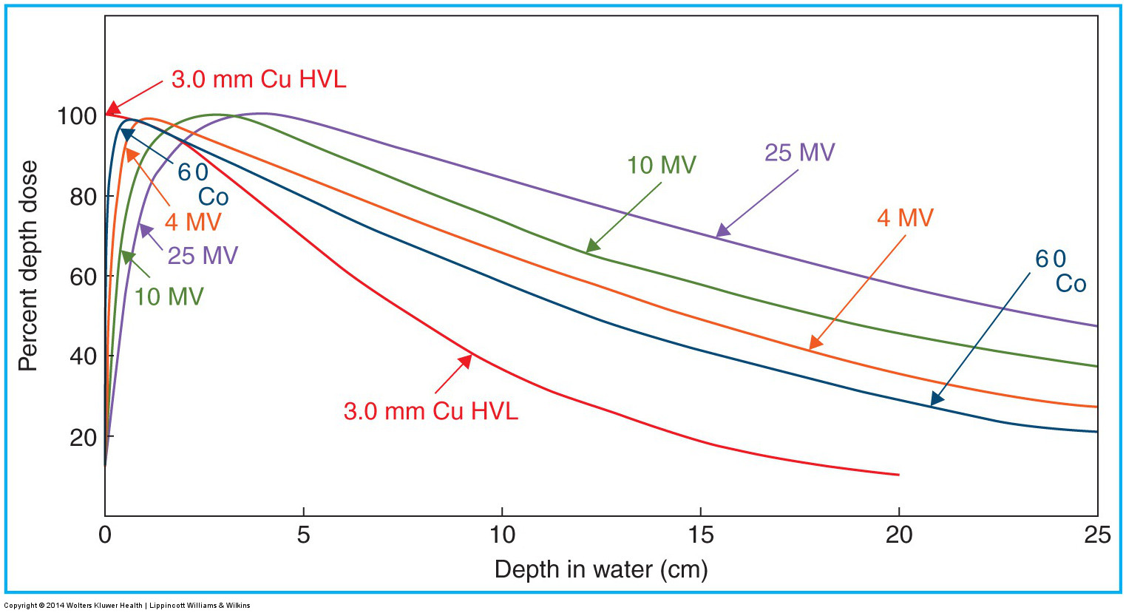
PDD Energy Dependence
PDD ↑ as Energy ↑ (beyond D_{max})
Decreased beam attenuation

Slide 4
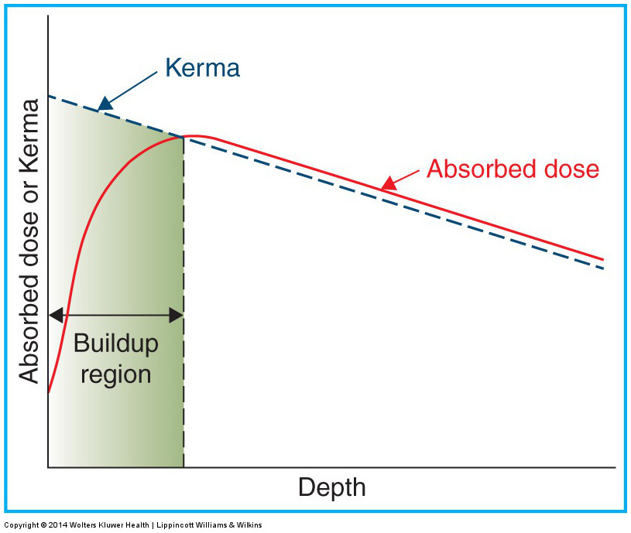
PDD Depth Dependence
PDD ↓ as Depth ↑ (beyond D_{max})

Slide 5
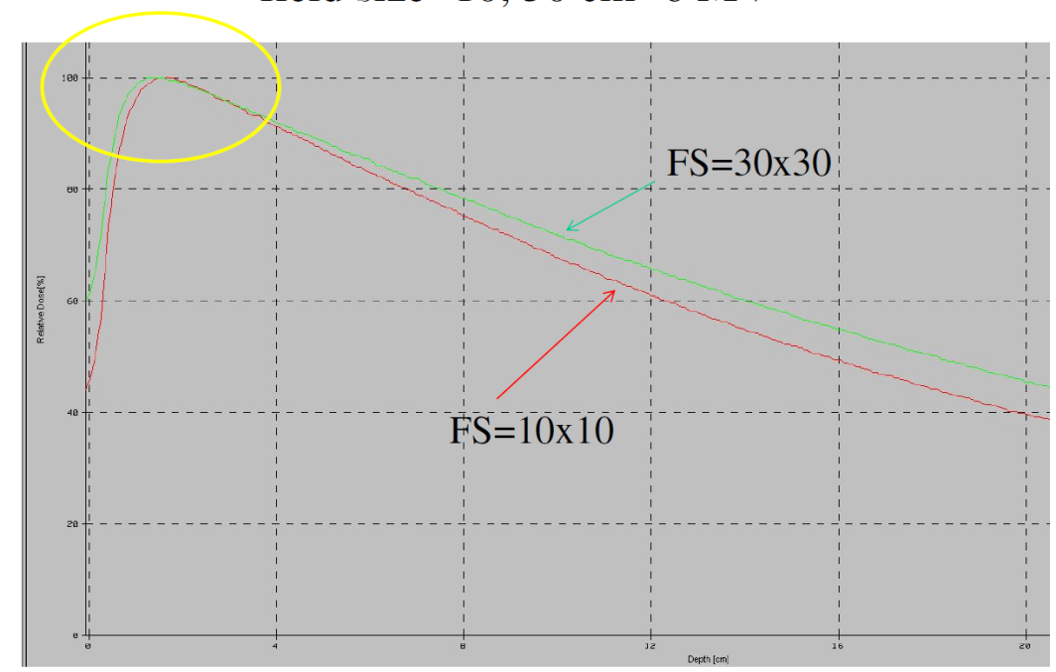
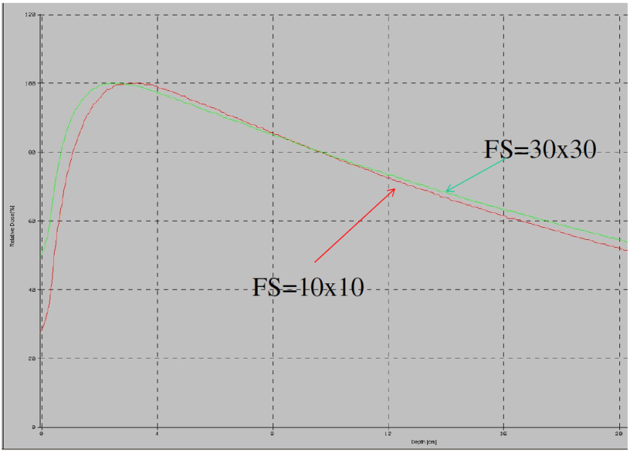
PDD Field Size Dependence
PDD and Surface Dose ↑ as FS ↑
D_{max} ↓ as FS ↑
Increased scatter contribution
6X 18X

Slide 6
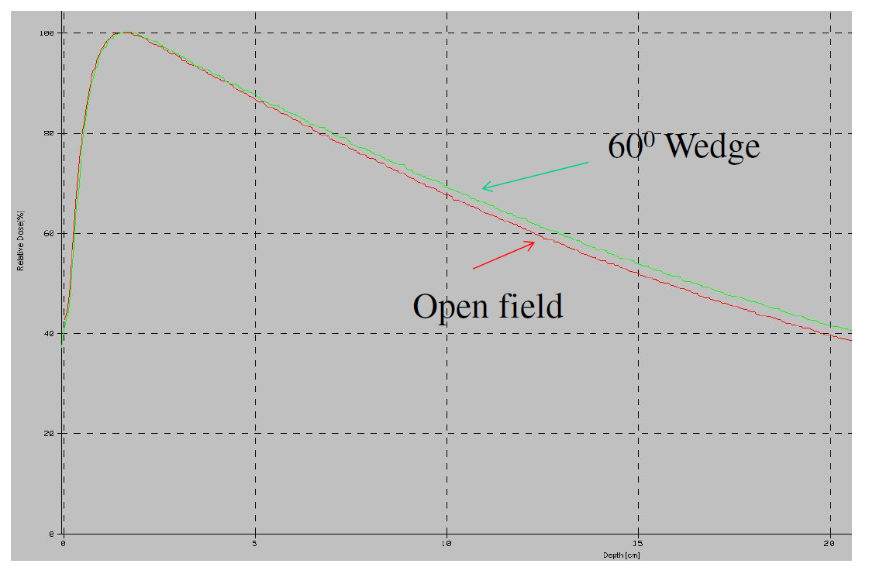
PDD Modifier Dependence
PDD ↑ with modifier use
Surface dose can ↓ with fixed wedge due to reduce electron contamination

Slide 7
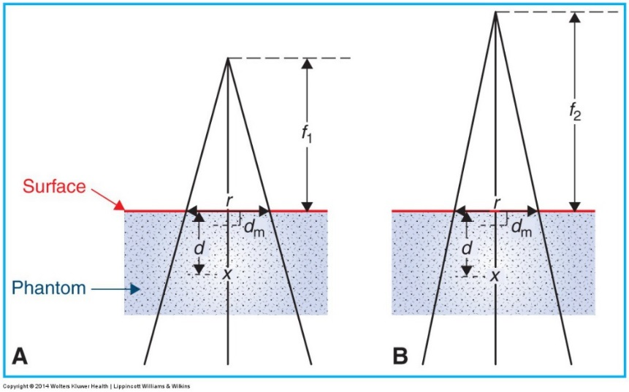
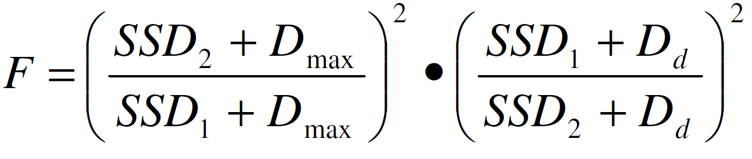
PDD SSD Dependence
PDD ↑ with SSD ↑
Decreasing effect of depth on inverse square factor
Clinical tables tabulated for 100 SSD so convert using the Mayneord F Factor

Slide 8
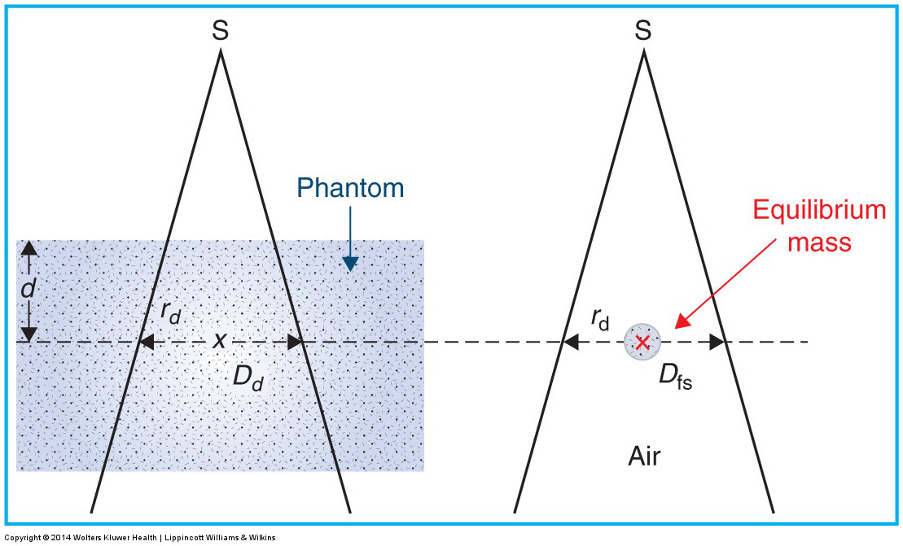

Tissue Air Ratio
TAR (d,r_{d}) = $\frac{D_{d}}{D_{f.s.}}$
Function of depth and field size @ depth

Slide 9
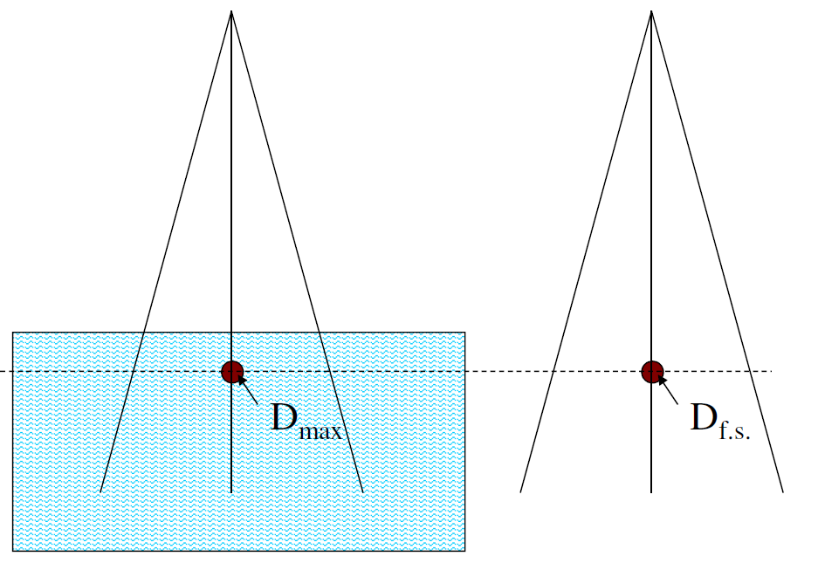
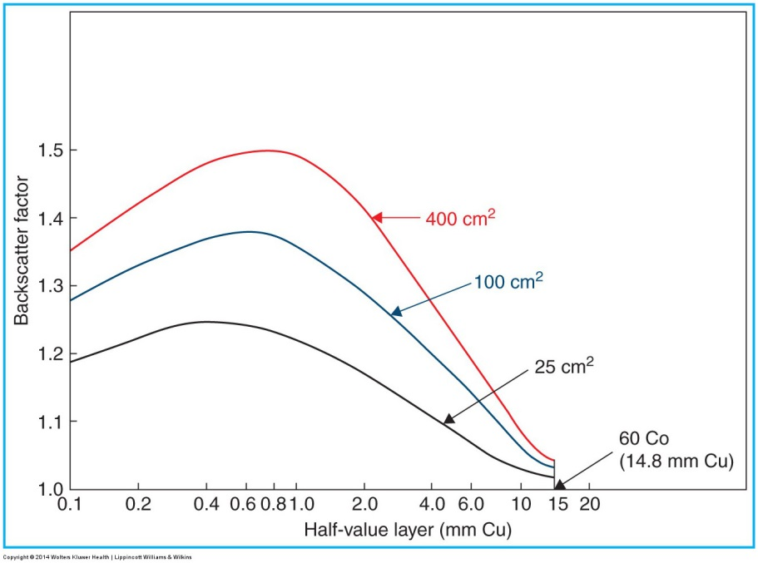
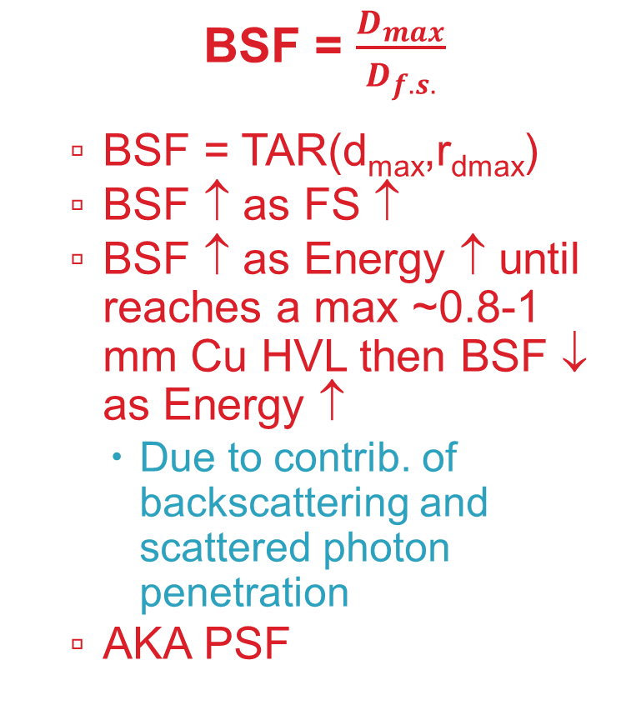
Backscatter Factor
BSF = $\frac{D_{max}}{D_{f.s.}}$
BSF = TAR(d_{max},r_{dmax})
BSF ↑ as FS ↑
BSF ↑ as Energy ↑ until reaches a max ~0.8-1 mm Cu HVL then BSF ↓ as Energy ↑
Due to contrib. of backscattering and scattered photon penetration
AKA PSF

Slide 10
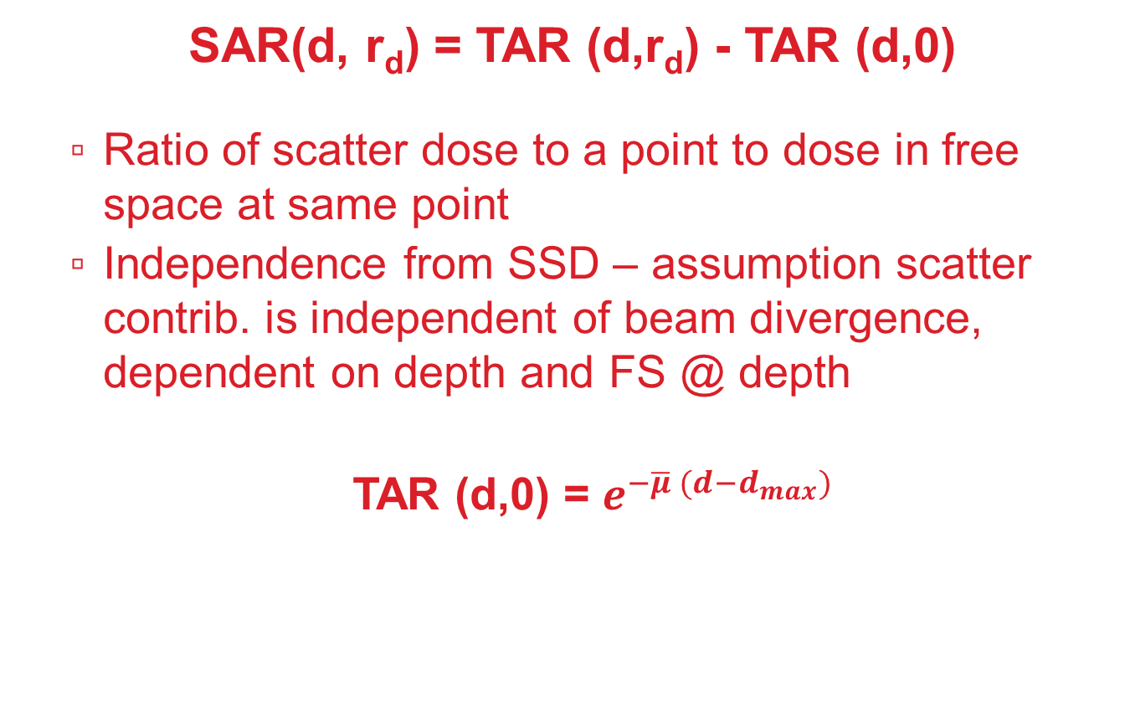
Scatter Air Factor
SAR(d, r_{d}) = TAR (d,r_{d}) - TAR (d,0)
Ratio of scatter dose to a point to dose in free space at same point
Independence from SSD – assumption scatter contrib. is independent of beam divergence, dependent on depth and FS @ depth
TAR (d,0) = $e^{−\overline{μ} (d−d_{max})}$

Slide 11
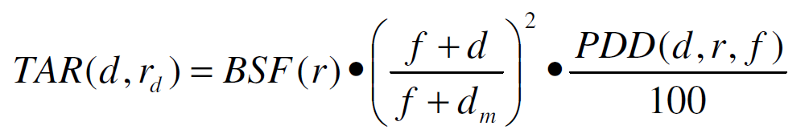
PDD to TAR conversion

Slide 12
Clarkson
Irregular fields
Notes:
10X

Slide 13
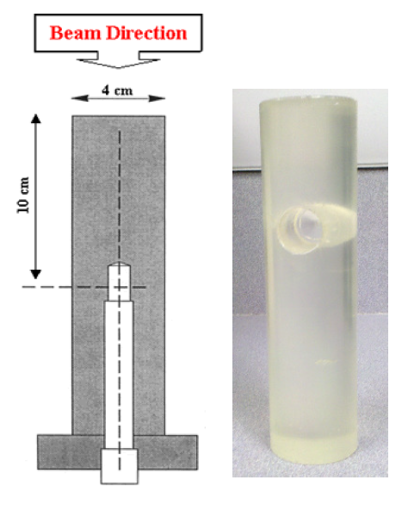
Collimator Scatter Factor
Ratio of the output in air for a given field to that for ref field
SSD independent
Need maximum dose build-up
FS large enough to cover phantom
Difficult to measure small FS’s (extended SSDs then convert to nominal SSD)
Sufficient cross section = lateral scatter equilibrium
Sufficient thickness = make electron contamination negligible

Slide 14
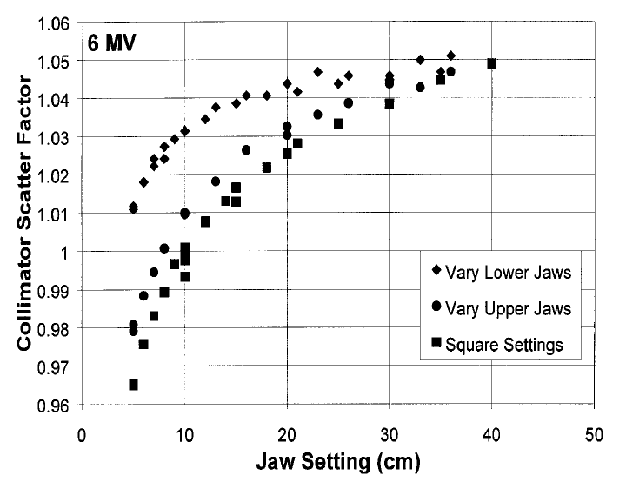
Collimator Exchange Effect
Due to different source views and backscatter into monitor chamber
S_{c}(a,b) ≠ S_{c}(b,a)
Typically <2% effect

Slide 15
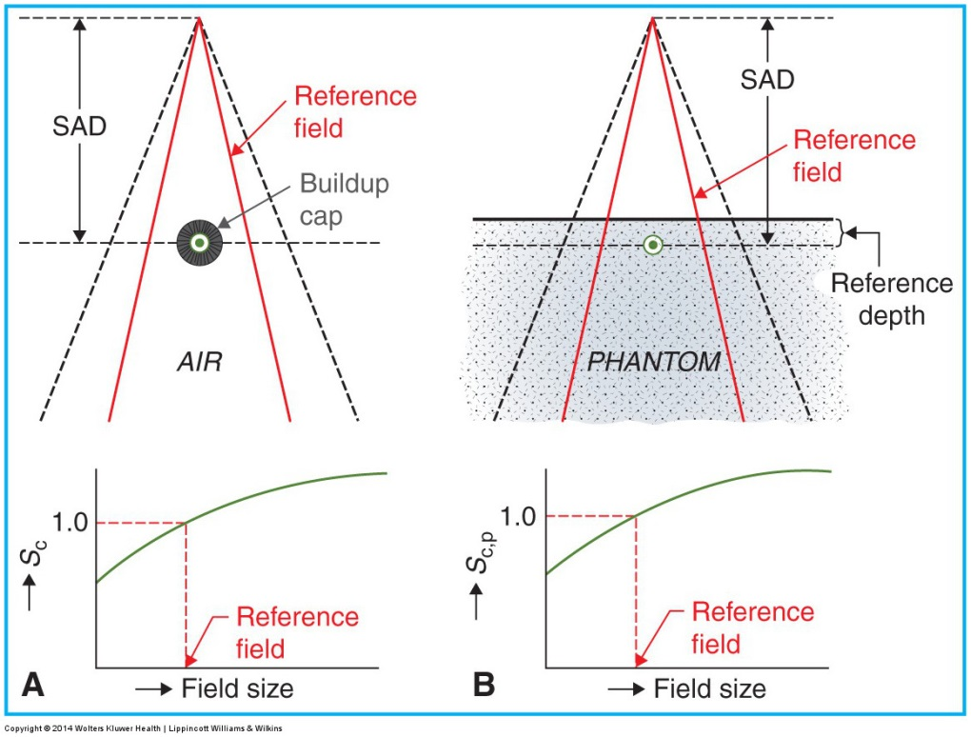

Phantom Scatter Factor
Ratio of dose rate for a given field at ref depth to the dose rate at same depth for ref field size (fixed collimator opening)
S_{p}(r) = $\frac{S_{c,p}(r)}{S_{c}(r)}$
Sc setup Sc,p setup
Notes:
Co-60

Slide 16
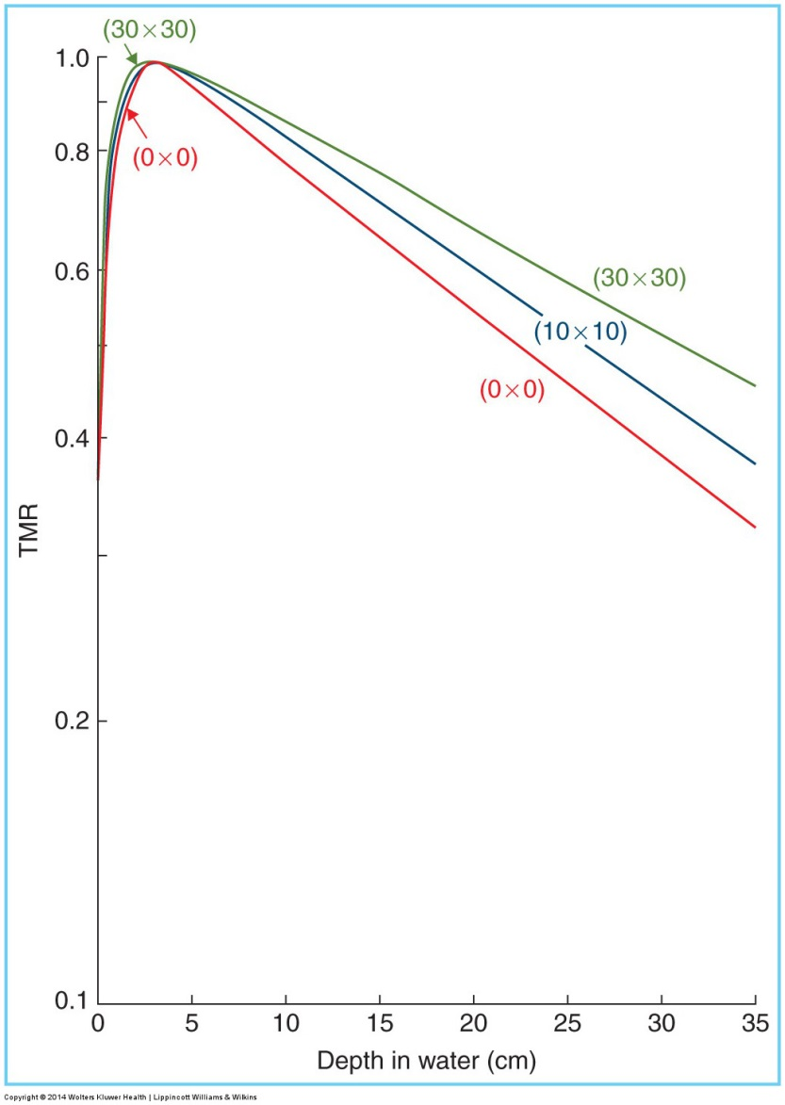
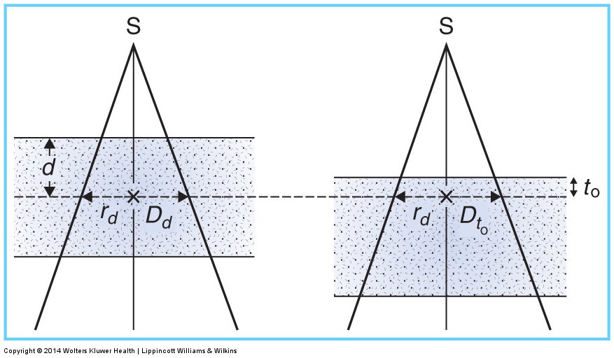
Tissue Phantom Ratio
Ratio of dose at a given point in a phantom to dose at the same point at fixed ref depth
TMR(d,0) steepest drop, caused entirely by primary beam

Slide 17
Beam Profiles
10X
Penumbra depends on: collimators, focal spot size, lateral electronic disequilibrium
Geometric (source size)
Transmission (collimators)
Scatter (in-patient)
p₂₀₋₈₀ Co-60 ~10-15 mm
p₂₀₋₈₀ LINAC ~6mm (@d_{max})
Larger than predicted (based on source size) due to flattening filter (broaden)
Cobalt-60
Notes:
10X

Slide 18
Beam Profiles
Central region (linacs) depends on: electron energy impinging target, target atomic number, flattening filter atomic number and shape
Beam divergence causes profiles to become wider with depth
Horns gradually decrease w/ depth – in scatter/out-scatter imbalance at beam edge, softer beam quality away from central axis (flattening filter shape)
10X
Notes:
10X

Slide 19
Flatness and Symmetry
Flatness
Measured with central 80%
Less than 3% (d=10cm, SSD=100cm, largest FS)
Causes over-flattening at dmax (horns), under-flattening depths beyond 10 cm due to lower beam effective energy in off-axis directions
Symmetry
Within 2% (d=dmax)
Notes:
10X

